Slide 1
Lecture 9
Runge-Kutta Methods
Case study

Slide 2
Introduction
In this lecture we present how the Runge-Kutta methods are applied to a situation where the true solution is not known and how we can be confident about our error estimations
The solution process using an IVP solver will in general involve:
Solve graphically the IVP (slope fields)
Solve the IVP for various step sizes with a chosen solver
Identify the region where the error decrease is controlled by the truncation error
Estimate the truncation error using the Richardson error formula
Compute a numerical solution
Notes:
In this lecture we present how the Runge-Kutta methods are applied to a situation where the true solution is not known and how we can be confident about our error estimations
The solution process using an IVP solver will in general involve the following steps:
First solve graphically the IVP using the methods of slope fields
Second, solve the IVP for various step sizes with a chosen solver
Third, identify the region where the error decrease is controlled by the truncation error
Fourth step is to estimate the truncation error using the Richardson error formula
And finally we compute a numerical solution

Slide 3

Sample problem
We want to solve
$$\left\{\begin{aligned}\frac{dy}{dt}=−0.6y+10e^{−100{\left(t−2\right)}^{2}} \\ y\left(0\right)=0.5\end{aligned}\right.$$
Notes:
In this lecture we will consider the initial value problem $\frac{dy}{dt}=−0.6y+10e^{−100{\left(t−2\right)}^{2}}$ with the initial condition y(0)=0.5

Slide 4
Slope field
Notes:
We first use the slope fields to get a rough idea on how ill look the solution
Using matlab or octave this is quite straight forward to do

Slide 5

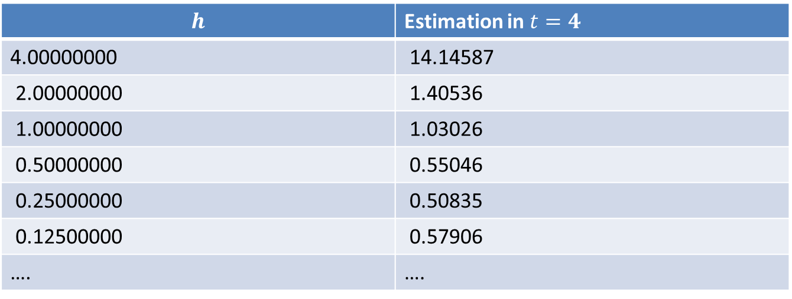
Solving with an IVP solver
We use the classical RK4 method to solve the IVP on the interval from 0 to 4
For different step sizes we compute the estimation in $t=4$
$$h$$ | Estimation in $t=4$
4.00000000 | 14.14587
2.00000000 | 1.40536
1.00000000 | 1.03026
0.50000000 | 0.55046
0.25000000 | 0.50835
0.12500000 | 0.57906
…. | ….
Notes:
Next we choose a IVP solver for our problem
We will use the most accurate one we learned so far: the classical RK4 method
Then we solve the IVP for different step sizes until a final value of t. In our case we compute the approximations from the initial condition t=0 to the final value of t=4
The displayed table lists the approximations computed in t=4 for different step sizes
As we don’t yet know which step size will give us good results, we start with large step sizes and progressively compute with smaller ones

Slide 6
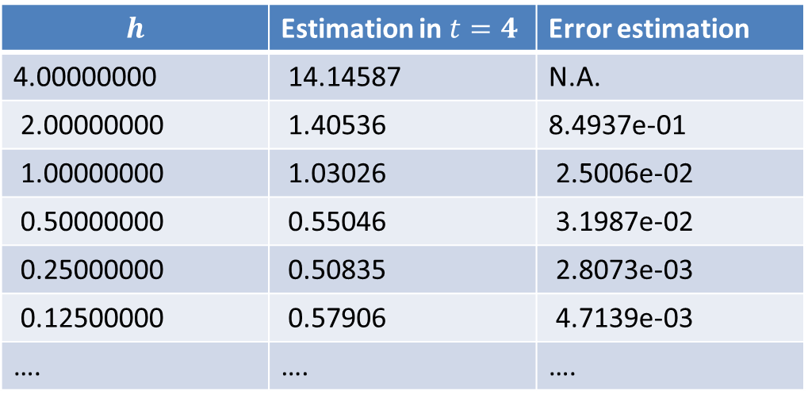
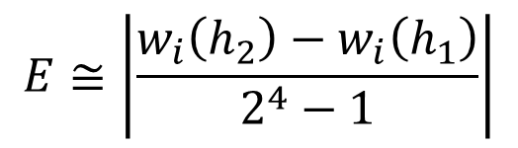
Error estimation
$$h$$ | Estimation in $t=4$ | Error estimation
4.00000000 | 14.14587 | N.A.
2.00000000 | 1.40536 | 8.4937e-01
1.00000000 | 1.03026 | 2.5006e-02
0.50000000 | 0.55046 | 3.1987e-02
0.25000000 | 0.50835 | 2.8073e-03
0.12500000 | 0.57906 | 4.7139e-03
…. | …. | ….
$$E≅\left|\frac{w_{i}\left(h_{2}\right)−w_{i}\left(h_{1}\right)}{2^{4}−1}\right|$$
Notes:
For each step size, expect the first one, we can compute an estimation of the truncation error using Richardson’s error formula
I invite you to check the estimated errors listed in the table using the Richardson error formula

Slide 7
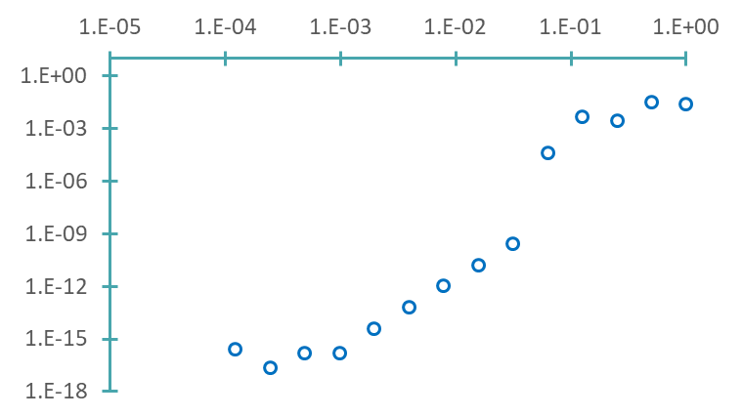


Error plot
$$h$$
Richardson formula not valid
Estimated error in $t=4$
For step sizes between about 0.05 and 0.001 we estimate correctly the truncation error
Round-off errors
Truncation errors
Notes:
Plotting the estimated errors in function of the step size allows us to identify for which values of the step size we can be confident of our estimations. We look fr the region in error plot in which the error decreases according the order of the used IVP solver, which is four in our case
On the plot we can identify three regions
For very small values of the step size we note that the error doesn’t decrease further, in fact it even increases
This is the region controlled by the round-off errors
We observe as well a region, for intermediate values of the step size, in which the error decreases according the expected order of four
That is the region where the truncation error dominates
And finally, for large values of the step size we observe a region where the error decreases but not according the expected order of four
In this region the Richardson error formula is not valid and we can not be confident about the error estimation
Note that for other example, the error can even increase in this region
To summarize, we can state that for step sizes between about 0.05 and 0.001 we estimate correctly the truncation error because the error behaves as expected

Slide 8
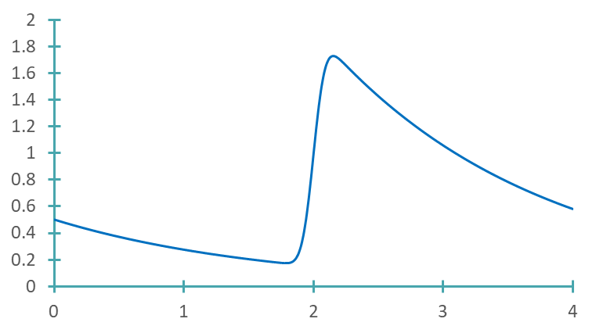


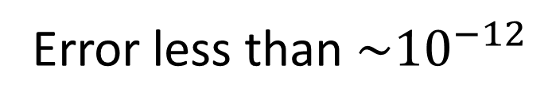

Numerical solution
$$y$$
$h=0.005$
Error less than ${\sim 10}^{−12}$
$$t$$
Notes:
To finish, we can compute a numerical solution of our IVP using a step size in the identified region.
Here we present an example for h=0.005
According the error plot form the previous slide, we expect the error to be less than about ${\sim 10}^{−12}$

Slide 9
Summary
Solving an initial value problem with an IVP solver with various step sizes allow to apply Richardson's error formula to estimate the truncation error
On the error plot displaying the estimated error in function for the step size, we can identify for which step sizes we are confident to estimate correctly the truncation error
Based on the error plot we can then choose an appropriate step sizes allowing us to reach a desired precision
Notes:
Let us summarize the key findings
Solving an initial value problem with an IVP solver with various step sizes allow to apply Richardson's error formula to estimate the truncation error
On the error plot displaying the estimated error in function for the step size, we can identify for which step sizes we are confident to estimate correctly the truncation error
Based on the error plot we can then choose an appropriate step sizes allowing us to reach a desired precision

